Slide 1

Introduction to neural coding analysis
Alberto Mazzoni
@Bionics Engineering
2025-206

Slide 2

Shannon’s Information
s
r
Shannon’s Information : it quantifies the average reduction of uncertainty (=information gained) after a single-trial observation of the neural response
Measured in bits. 1 bit = reduction of uncertainty by a factor of 2 (like a correct answer to a yes/no question)
I(Guess Who|woman) = 4.58 - 3.97 = 0.61 bits ;
I(Real World|woman) = 1 bit;

Slide 3
Information key equations
R | Stim 1 | Stim 2
Trial 1 | 10 | 5
Trial 2 | 9 | 3
Trial 3 | 8 | 5
Trial 4 | 10 | 4
R | Stim 1 | Stim 2
Trial 1 | 7 | 5
Trial 2 | 5 | 3
Trial 3 | 8 | 5
Trial 4 | 4 | 4
I(S;R) =1 bit
I(S;R) =0.045 bit

Slide 4

Repeat
Each stimulus must be presented many times (trials) in order to get a good estimate of the probabilities and hence of the information.

Slide 5
Good question 1: what about continuous variables?
If R is a set of continuous variables every r will appear exactly once and we will have no serious estimate of P(r) and P(r|s). So both sets need to be binned.
What is the relationship between the number of bins and starting entropy?
Given the starting entropy, how do I bin the response?

Slide 6
Good question 1: what about continuous variables?
If R is a set of continuous variables every r will appear exactly once and we will have no serious estimate of P(r) and P(r|s). So both sets need to be binned.
What is the relationship between the number of bins and starting entropy?
They positively correlate
Given the starting entropy, how do I bin the response?
Indicatively, to have at least the same starting entropy, BUT…...

Slide 7

Binning the variables
To maximize entropy the best binning is equipopulated bins.
Demonstrationis left to the reader

Slide 8
Combining different responses
R1 | Stim 1 | Stim 2 | Stim 3
Trial 1 | 10 | 5 | 4
Trial 2 | 9 | 3 | 5
Trial 3 | 8 | 5 | 5
Trial 4 | 10 | 4 | 3
R2 | Stim 1 | Stim 2 | Stim 3
Trial 1 | 3 | 1 | 9
Trial 2 | 1 | 0 | 8
Trial 3 | 0 | 3 | 8
Trial 4 | 2 | 2 | 9

Slide 9
Combining different responses
S
s1
s2
s3
s4
R1
r11
r12
r13
r14
R2
r21
r22
r23
r24

Slide 10
Redundancy
1
1
1.585
R1 | Stim 1 | Stim 2 | Stim 3
Trial 1 | 10 | 5 | 7
Trial 2 | 9 | 3 | 5
Trial 3 | 8 | 5 | 6
Trial 4 | 10 | 4 | 7
R2 | Stim 1 | Stim 2 | Stim 3
Trial 1 | 3 | 1 | 9
Trial 2 | 1 | 0 | 8
Trial 3 | 0 | 3 | 8
Trial 4 | 2 | 2 | 9
Redundancy>0

Slide 11

Advanced information theory: BIAS

Slide 12


Low probabilities are difficult to estimate

Slide 13
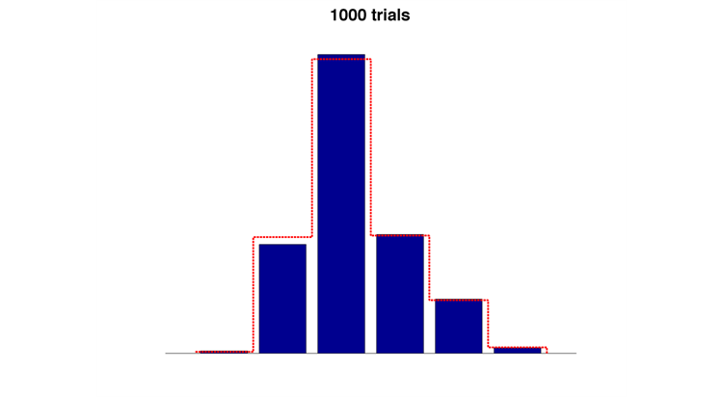
The “plug-in” information estimation
The most direct way to compute information and entropies is the “plug-in” method: estimate the response probabilities P(r|s) and P(r) as the experimental histogram of the frequency of each response across the available trials and then plug these empirical probability estimates into entropy Equations.

Slide 14
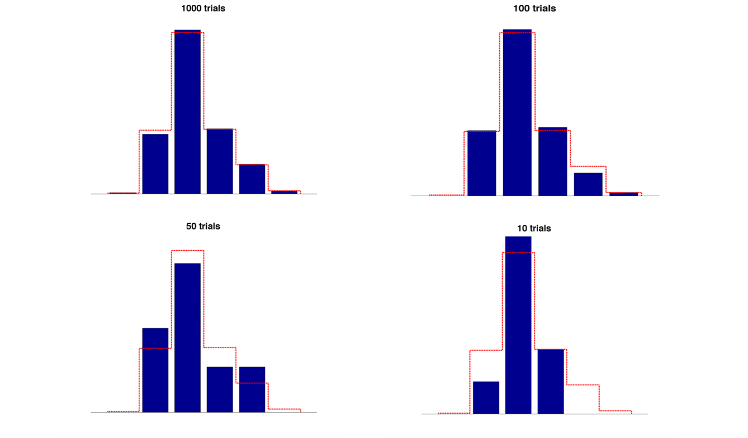
The limited sampling bias
The problem with the plug-in estimation is that these probabilities are not known but have to be measured experimentally from the available data.
The estimated probabilities are subject to statistical error and necessarily fluctuate around their true values. The significance of these finite sampling fluctuations is that they lead to both systematic error (bias) and statistical error (variance) in estimates of entropies and information. These errors, particularly the bias, constitute the key practical problem in the use of information with neural data.
If not corrected, bias can lead to serious misinterpretations of neural coding data.
SR
Panzeri, S., Senatore, R., Montemurro, M. A., and Petersen, R. S. (2007). Correcting for the sampling bias problem in spike train information measures. J Neurophysiol 98, 1064-1072. Review paper
S Panzeri, C Magri, L Carraro (2008) Sampling bias – Scholarpedia article (freely accessible)

Slide 15
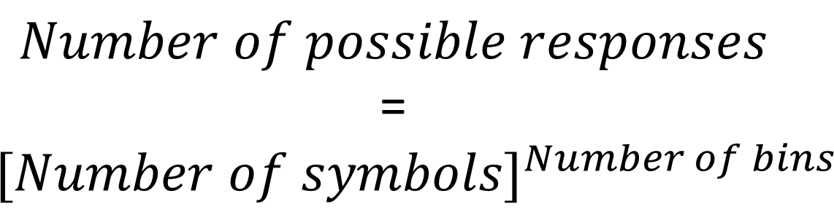
Dimensionality curse
0 | 1 | 1 | 2 | 1 | 3 | 6 | 2 | 4 | 5
$$Number of possible responses$$
=
$${[Number of symbols]}^{Number of bins}$$

Slide 16
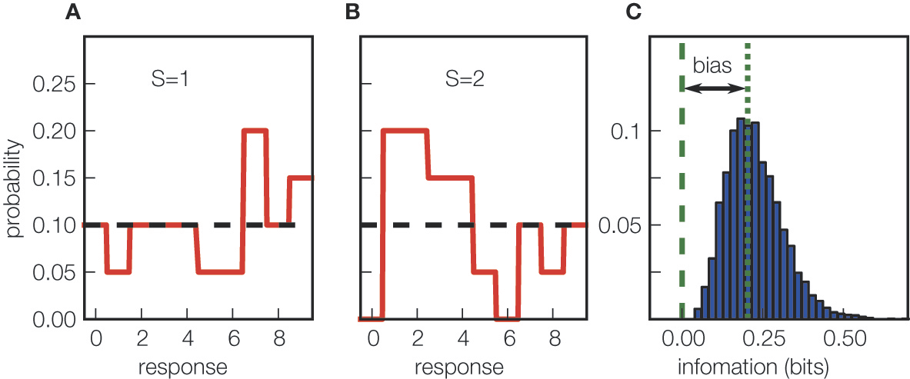
Statistics of information values: bias and variance due to limited sampling
The bias of a given functional F of a probability distribution P is defined as the difference between the trial-averaged value of F when the probability distributions are computed from N trials only and the value of F computed with the true probability distributions (obtained from infinite number of trials).
SR
Ince et al (2010) Frontiers Neurosci
Panzeri et al (2007) J Neurophysiol
Ince et al (2010) Frontiers Neurosci
Panzeri et al (2007) J Neurophysiol

Slide 17
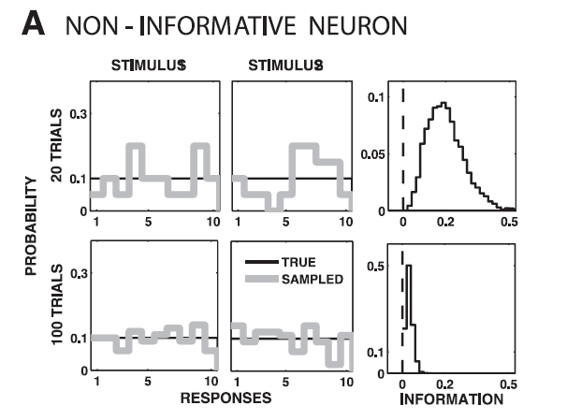
The limited sampling bias
1
2
Notes:
The case of un uninformative neuron :
1- We have 2 stimuli , these are the possible responses and the green line represent the TRUE probability distribution
That describe the behaviour of this neuron. In this case we have zero information transmitted.
In fact there is no correlation between the response and the stimuli
2-any way when we can only sample it we get (for example ) this red line and
It seem that the second stimulus has a higher firing rate so apparently the neuron is conveying some information !!

Slide 18
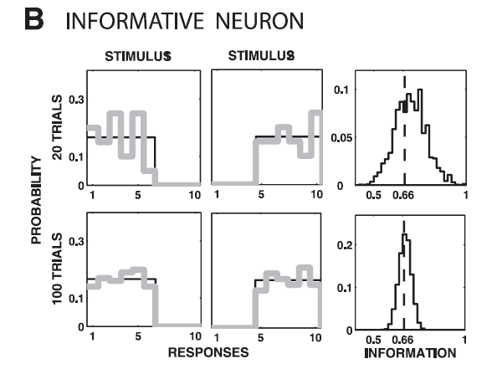
The limited sampling bias
1
2
Notes:
The case of un uninformative neuron :
1- We have 2 stimuli , these are the possible responses and the green line represent the TRUE probability distribution
That describe the behaviour of this neuron. In this case we have zero information transmitted.
In fact there is no correlation between the response and the stimuli
2-any way when we can only sample it we get (for example ) this red line and
It seem that the second stimulus has a higher firing rate so apparently the neuron is conveying some information !!

Slide 19
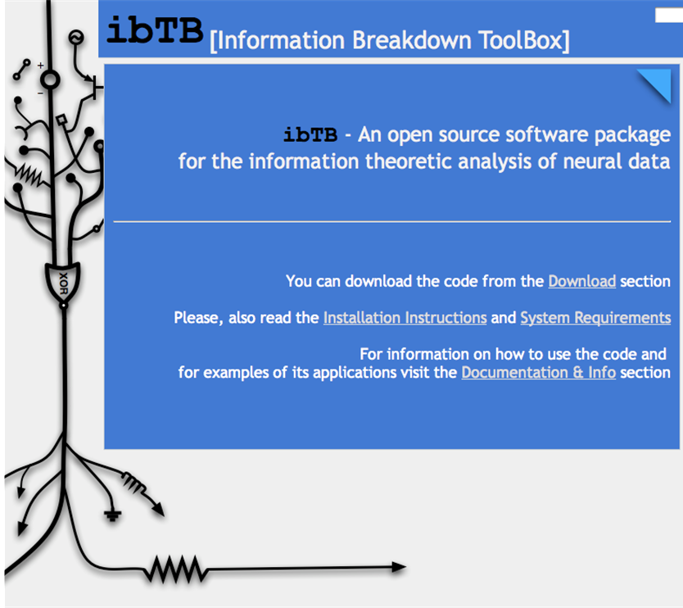
Procedures to alleviate – eliminate the bias
Bootstrapping
and subtracting
Quadratic Extrapolation
Panzeri Treves correction
Shuffling
(for 2 dimensions or more)
SR
C Magri et al 2009 BMC Neuroscience

Slide 20
The Information Bias – Asymptotic expansion
This expansion converges only if N is large (large enough that each response with non-zero probability is observed several times)
Note: All coefficients are non-negative
Miller, 1955
Treves & Panzeri 1995
Panzeri & Treves, Network 1996
Victor, Neur. Comp. 2000
Paninski, Neur. Comp. 2003

Slide 21
The Quadratic Extrapolation
-) Collect N data
-) Divide then into blocks of N/2 , N/4 …
-) Compute average information for N , N/2 , N/4 ... Data and fit the dependence of I on N to the above quadratic expression
-) Estimate the true (N=∞) value from the best-fit expression

Slide 22
The boostrapping and subtracting method
One way to estimate the bias is to randomly “bootstrap” stimulus-response data pairs. The resulting information I_{boot} should be zero.
In practice, because of finite sampling, we will find I_{boot} > 0. The mean of the distribution of I_{boot} is equal to the bias of I_{boot}.
 | Stim 1 | Stim 2 | Stim 3
Trial 1 | 4 | 3 | 1
Trial 2 | 3 | 2 | 1
Trial 3 | 3 | 2 | 1
Trial 4 | 3 | 3 | 2
Trial 5 | 5 | 2 | 1
Tot | 18 | 12 | 7
 | Stim 1 | Stim 2 | Stim 3
Trial 1 | 1 | 3 | 4
Trial 2 | 3 | 1 | 2
Trial 3 | 1 | 3 | 2
Trial 4 | 3 | 3 | 2
Trial 5 | 1 | 5 | 2
Tot | 9 | 15 | 12
boott

Slide 23
Bootstrapping as test
A complementary possibility is to use bootstrap as test (as we have seen with correlation). You permute n*20 times and you assess the level of p=0.05 significance by taking the n-th highest value.
Be sure to have enough data to generate n*20 independent realizations!
 | Stim 1 | Stim 2 | Stim 3
Trial 1 | 4 | 3 | 1
Trial 2 | 3 | 2 | 1
Trial 3 | 3 | 2 | 1
Trial 4 | 3 | 3 | 2
Trial 5 | 5 | 2 | 1
Tot | 18 | 12 | 6
 | Stim 1 | Stim 2 | Stim 3
Trial 1 | 1 | 3 | 4
Trial 2 | 3 | 1 | 2
Trial 3 | 1 | 3 | 2
Trial 4 | 3 | 3 | 2
Trial 5 | 1 | 5 | 2
Tot | 9 | 15 | 12
boott

Slide 24
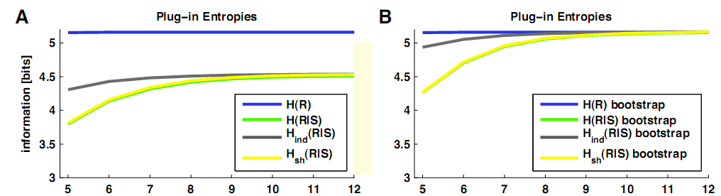
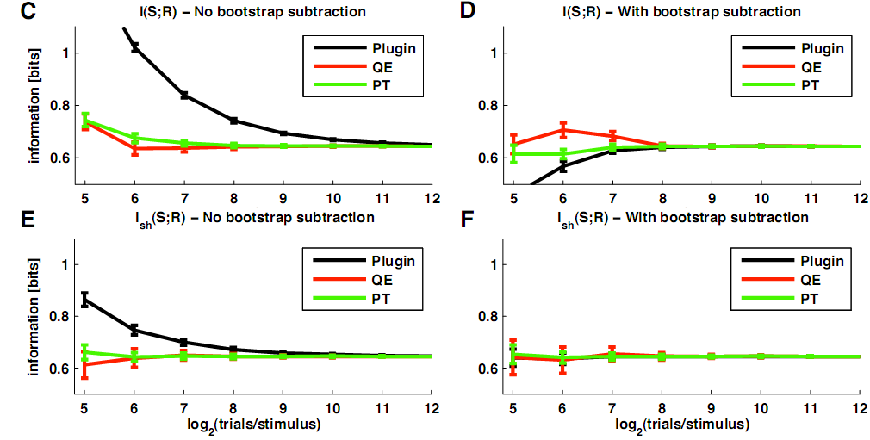

Slide 25
My favorite: QE + shuffling and no bootstrap correction. Fast convergence and I use bootstrap to test significance.

Slide 26
Sampling rules of thumb for I(S;R)
The previous results suggest rules of thumb for data sampling (i.e. the number of trials per stimulus Ns) necessary to obtained unbiased information estimates:
If no bias correction is used:
Ns >> number of possible responses R
If we use an appropriate bias correction, then the constraint on data becomes much better:
Ns ≥ number of possible responses R

Slide 27
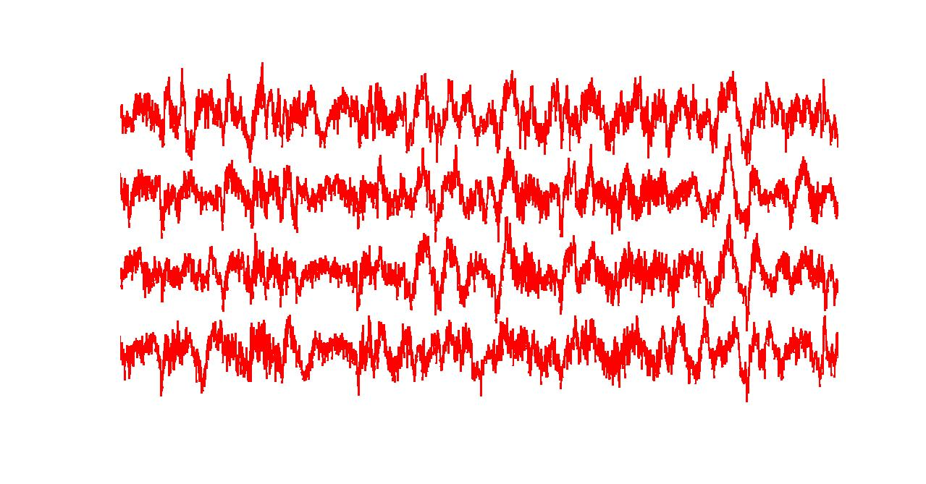
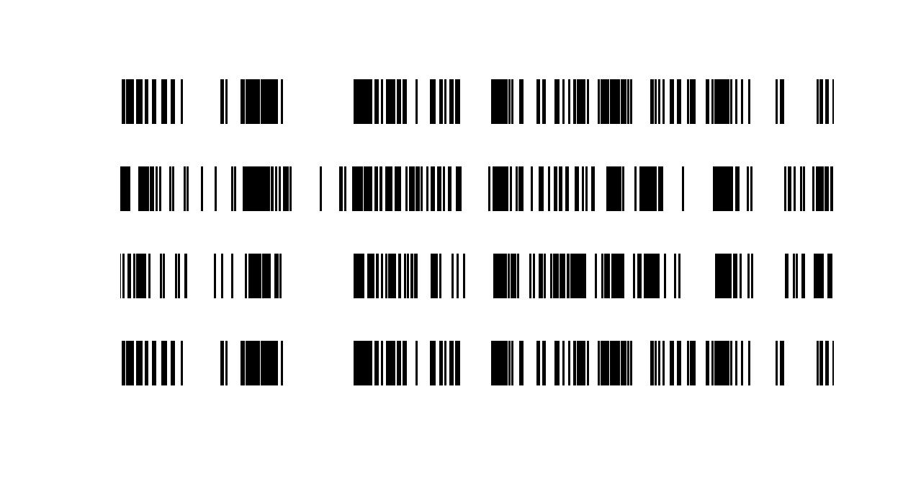
Response to multiple presentations
of the same movie clip
Single unit activity - 10 secs
Local Field Potential - 10 secs
The code must be composed by features that are DIFFERENT from scene to scene and SIMILAR across trials
Notes:
Remember the monkeys

Slide 28
Response to multiple presentations
of the same movie clip
Reliability: the response is similar across different presentations of the same stimuli. (Important to define properly what do we mean with «similar»)
Sensitivity: The response to different stimuli is not similar (on average across presentations).
You need BOTH things for a code to be informative
Single unit activity - 10 secs
Local Field Potential - 10 secs
The code must be composed by features that are DIFFERENT from scene to scene and SIMILAR across trials
Notes:
Remember the monkeys

Slide 29
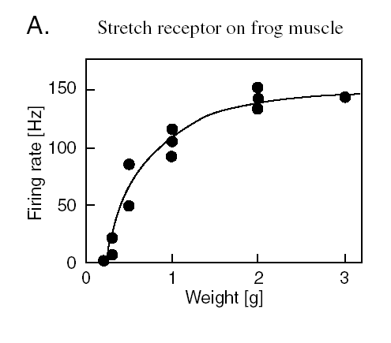
The spike count hypothesis
The simple hypothesis is that the intensity of the stimulus is encoded by the number of spikes emitted by the neuron: the higher the stimulus intensity, the higher the number of spikes emitted by the neuron
The spike count hypothesis is also called the firing rate hypothesis (firing rate = number of spikes per second)
Lord Adrian (1928). The pioneer of the spike count code.
He showed that the number of spikes emitted by a frog’s stretch receptor on a muscle increased when increasing the weight load applied to the muscle.
Spike counts increased with stimulus intensity.
IT WORKS 80% OF THE TIMES OR MORE FOR INTENSITY MEASURES (CONTRAST, PRESSURE)

Slide 30
The spike count hypothesis
The simple hypothesis is that the intensity of the stimulus is encoded by the number of spikes emitted by the neuron: the higher the stimulus intensity, the higher the number of spikes emitted by the neuron
The spike count hypothesis is also called the firing rate hypothesis (firing rate = number of spikes per second)
Spike count: you identify the relevant response window to a given set of stimuli. The stimulus identity is encoded by the number of spikes fired in the window.
Lord Adrian (1928). The pioneer of the spike count code.
He showed that the number of spikes emitted by a frog’s stretch receptor on a muscle increased when increasing the weight load applied to the muscle.
Spike counts increased with stimulus intensity.
IT WORKS 80% OF THE TIMES OR MORE FOR INTENSITY MEASURES (CONTRAST, PRESSURE)

Slide 31

The spike count hypothesis - refined
The number of spikes emitted by the neuron can also encoded the identity of the stimulus (not only its intensity or magnitude).
Example: face-selective neurons in Inferior Temporal (IT) cortex of monkeys.
They encode the identity or the emotion of a face by increasing the total number of emitted spikes only when certain faces are presented to the animal

Slide 32
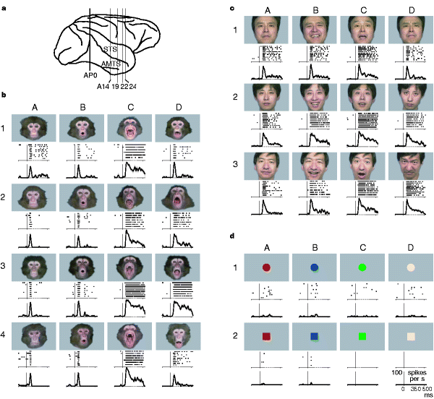
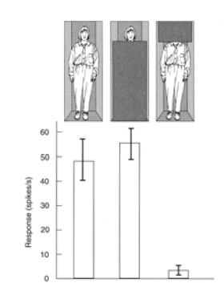
Face neurons
A face neuron responds only to faces (to some faces, not to all faces).
Coding of face identity
A face neuron does not respond to simple stimuli (such as spots of light etc) or when the face is removed from view

Slide 33
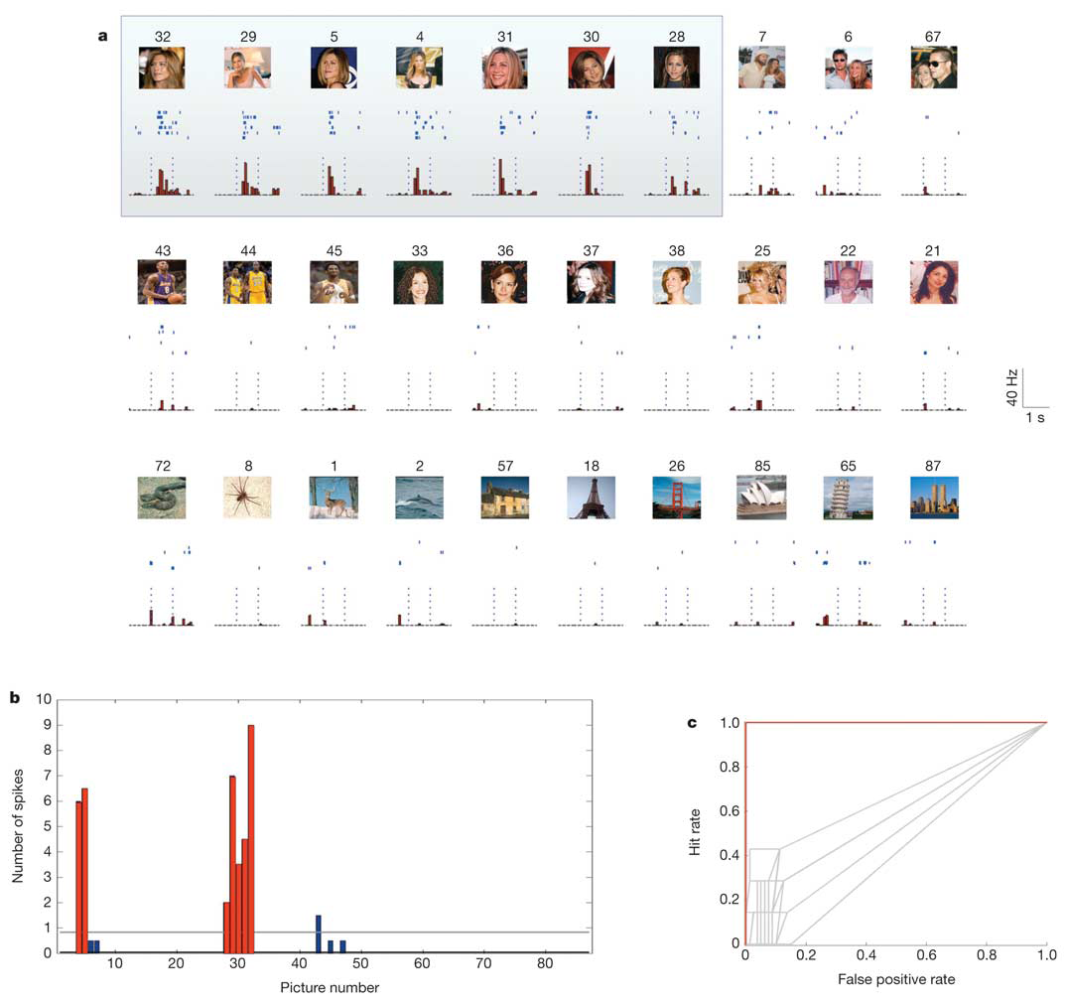
Nineties glam neuroscience
Spike counts encode Jennifer Aniston’s identity in human temporal lobe
RQ Quiroga et al Nature 2005

Slide 34
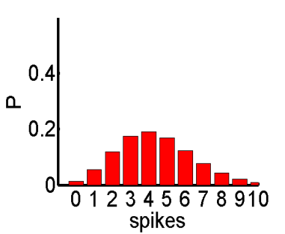
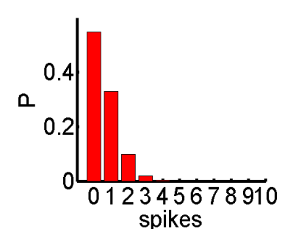
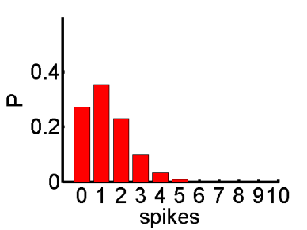
Information analysis with dynamic stimuli
Trials
s_{A}
s_{B}
1 sec

Slide 35

Decoding

Slide 36
Decoding
This is not a course about decoding
Do not confound decoding tools with the decoding approach to BMI
Decoding (from brain to machine)-> to understand motor intentions, or a biomarker of a pathological symptom…..

Slide 37

Decoding algorithm from one-dimensional response using Bayes rule
To predict the stimulus s’ that generated a given response r, we can choose the stimulus that maximizes the posterior probability of have caused r

Slide 38
Decoding algorithm from one-dimensional response using Bayes rule
Statistics
(difficult)
Expectation /Design
Statistics (easy)
To predict the stimulus s’ that generated a given response r, we can choose the stimulus that maximizes the posterior probability of have caused r

Slide 39
Decoding algorithm from one-dimensional response using Bayes rule
Statistics
(difficult)
Decoding is useful to take a decision (even in suboptimal conditions)
Information is useful to have a complete description of the relationship between your data sets
Expectation /Design
Statistics (easy)
To predict the stimulus s’ that generated a given response r, we can choose the stimulus that maximizes the posterior probability of have caused r

Slide 40
Decoding algorithm from one-dimensional response using Bayes rule
Statistics
(difficult)
Expectation /Design
Statistics (easy)
Information analysis first
Decoding to finalize
To predict the stimulus s’ that generated a given response r, we can choose the stimulus that maximizes the posterior probability of have caused r

Slide 41
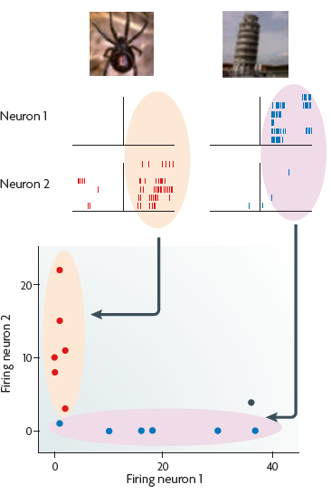
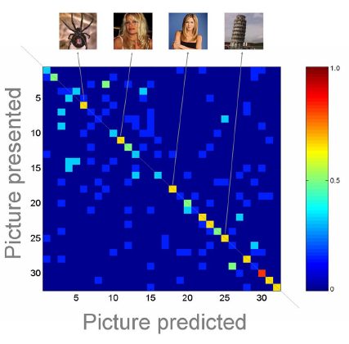
Decoding
(two-dimensional)
Stimulus presented
SR
Stimulus predicted
Always Quiroga and Panzeri 2009 NRN

Slide 42
Nothing to do with learning!!
Training and test in decoding
Leave one-out validation:
Consider once every single trial as test and all the others as training

Slide 43
Decoding using clustering algorithms
Look to the classification of the k nearest neighbors
Sometimes it works
Sometimes it doesn’t

Slide 44
Decoding using clustering algorithms
Divide the response space into regions. When the response falls in a given region, assign it to a stimulus. Optimal boundaries are difficult to find (you can use Support Vector Machines).

Slide 45
Information in the confusion matrix
I(S;S^{p}) quantifies the information than can be gained by a receiver that knows the true P(s|r) but only uses the information about which is the most likely stimulus
Stimulus presented s
Stimulus predicted s^{p}
Because of data processing inequality:

Slide 46
Information in the confusion matrix
The idea of the Confusion matrix
is to understand what’s going on beyond the diagonal.
This contributes to your understanding of the dynamics and can tell you how to improve your decoding.
I(S;S^{p}) quantifies the information than can be gained by a receiver that knows the true P(s|r) but only uses the information about which is the most likely stimulus
Stimulus presented s
Stimulus predicted s^{p}
Because of data processing inequality:

Slide 47
Information in the confusion matrix
Confusion matrix information
Quantifies the relevance of the clusters beyond the diagonal.
Note that information defines the optimal performance of decoding of a dataset. If you want to improve your decoding you can chose to improve you algorithm or your dataset.
I(S;S^{p}) quantifies the information than can be gained by a receiver that knows the true P(s|r) but only uses the information about which is the most likely stimulus
Stimulus presented s
Stimulus predicted s^{p}
Because of data processing inequality:

Slide 48

Information vs decoding

Slide 49
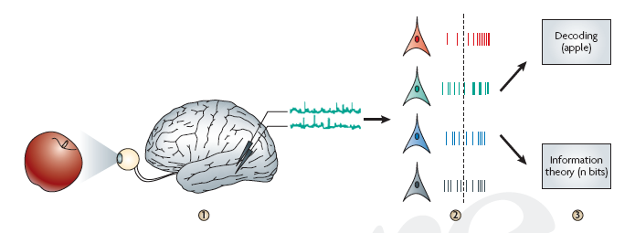
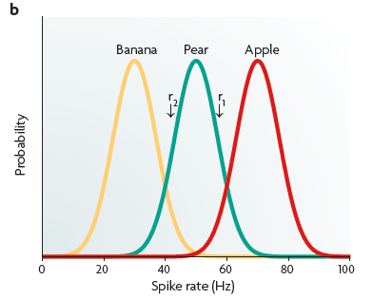
Single trial analysis toolboxes
(Information Theory and/or Decoding)
Decoding: predicting the most likely external correlate from neural activity
Information: quantifies the total knowledge (in units of bits) about external correlates that can be gained from neural activity
(1 bit = doubling the knowledge)
Quian Quiroga & Panzeri (2009) Nature Reviews Neuroscience

Slide 50
Advantages of information theory
It quantifies single-trial stimulus discriminability on a meaningful scale (bits)
It is a principled measure of the correlation on a single trial basis between neuronal responses and stimuli
It works even in non-linear situations
It makes no assumption about the relation between stimulus and response – we do not need to specify which features of the stimulus activate the response and how they activate it
Since it takes into account all ways in which a neuron can reduce ignorance, it bounds the performance of any decoder. Thus it can be used to explore features are best for stimulus decoding, without the limitations coming from committing to a specific decoding algorithm

Slide 51
Advantages of decoding techniques
Decoding algorithms are much easier to implement and compute
Calculations are robust even with limited amounts of data
Allow to test specific hypotheses on how downstream systems may interpret the messages
More direct implementation to engineering

Slide 52
Nineties glam neuroscience
Spike counts encode Jennifer Aniston’s identity in human temporal lobe
RQ Quiroga et al Nature 2005

Slide 53
Information analysis with dynamic stimuli
Trials
s_{A}
s_{B}
1 sec

Slide 54
The spike timing coding hypothesis
The spike timing coding hypothesis states that not only spike counts are important, but also the timing at which each spike was emitted.
Spike timing may convey additional information about the stimulus that is not conveyed by the spike counts alone.

Slide 55
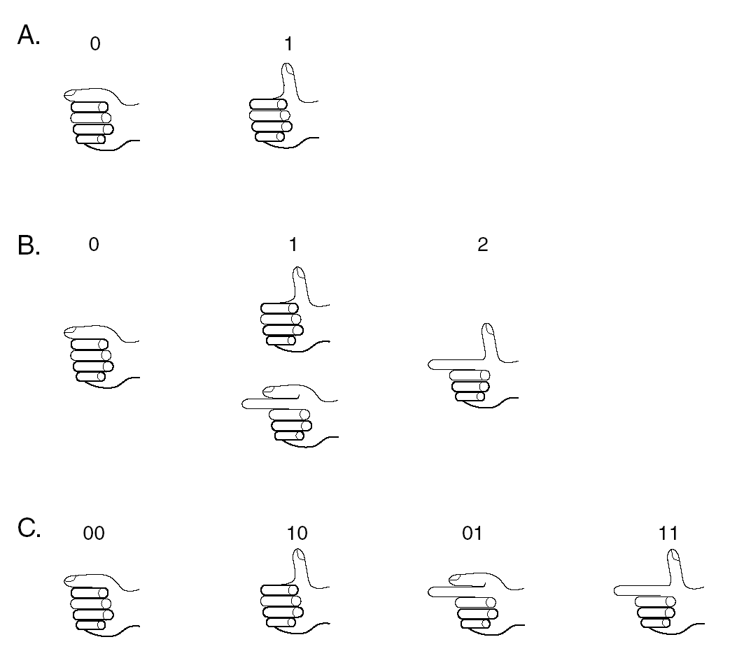
What is the advantage of a spike timing code?
Spike timing can code more information than spike counts alone.
Example, use your fingers to represent numbers
2 fingers are used to encode 3 different numbers by the total amount of extended fingers
2 fingers are used with a more complex code to encode 4 different numbers. Here the position of the extended finger is also used to signal – this increases the capacity to encode information

Slide 56
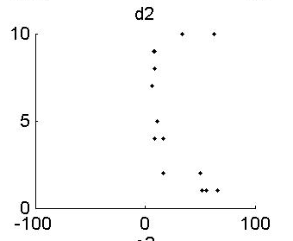
From spike count to spike timing
The response window is divided into subwindows
Spike
count
Spike
timing
1
0001
1
1000
1
1000
1
1000
0
0000
Stimulus trial
1
0100
2
1100
0
0000
1
0100
0
0000
0
0000
Post-stimulus time
Up to 5 numbers
2⁴ =16
numbers
The response becomes a binary vector
Notes:
The aim of quantifying neural coding is addressed by information theory. Since spike separation is important for what follows, all the following analysis used small arrays of tungsten electrodes.
The first step is to quantify the neural response. First, we define a response window - in this example, 0-40 ms post-stimulus. “Time spots” and PSTHs indicated that essentially the entire neuronal response was terminated by this time.. On a given trial, the spike count is simply the number of spikes that occurred in the response interval.
To consider spike timing, we divide the response interval into bins, here 10ms wide. The spike timing response is the 4-letter binary “word”.
Note that the spike count is completely redundant with the spike timing response. Thus the information in spike timing must be at least as great as that in the spike count.
We do this for each cell in the population on each trial, for each stimuli.

Slide 57
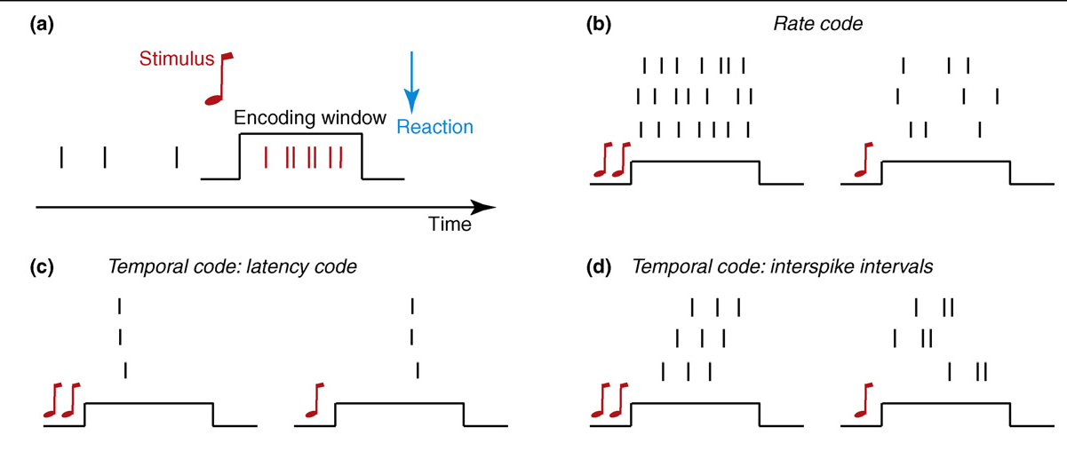
SR
Defining temporal codes
Panzeri et al 2010
There is temporal coding if the timing of spikes carries information about stimuli that cannot be possibly extracted from simply counting the spikes in the response time window

Slide 58
Defining temporal codes
Rate code is not a temporal code because you sum over the whole interval. It usually contains most or all the information.
There is temporal coding if the timing of spikes carries information about stimuli that cannot be possibly extracted from simply counting the spikes in the response time window

Slide 59
Defining temporal codes
Temporal codes based on latency work only if associated to a clock or if they are actually about relative latency.
There is temporal coding if the timing of spikes carries information about stimuli that cannot be possibly extracted from simply counting the spikes in the response time window

Slide 60
Defining temporal codes
The structure (not the distribution!) of the inter-spike intervals for a single neuron is the most relevant temporal code.
It is difficult to analyze due to the high dimensionality.
There is temporal coding if the timing of spikes carries information about stimuli that cannot be possibly extracted from simply counting the spikes in the response time window

Slide 61
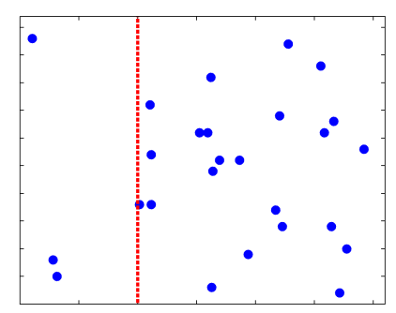
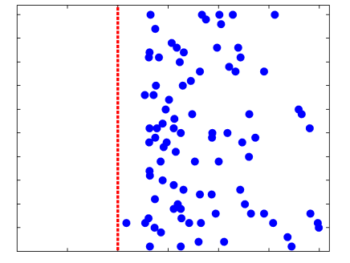
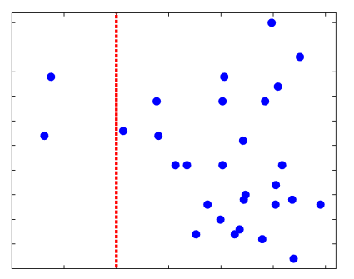
Temporal precision of neural codes
What is the minimal temporal precision with which we need to register the spikes in order to obtain as much information as possible about the stimuli?
Stim 1
Stim 2
Stim 3
0
40
Peri-stim Time (ms)
Notes:
* Stimulate 4 different whiskers in a row
* topography
distrbuted coding

Slide 62
ΔT = 20 ms
Spike
count
Spike
timing
1
01
1
10
1
10
1
10
0
00
Stimulus trial
1
01
2
20
0
00
1
10
0
00
0
00
40
Post-stimulus time
ΔT = temporal precision in registering the spikes
ΔT = temporal precision in registering the spikes
Notes:
The aim of quantifying neural coding is addressed by information theory. Since spike separation is important for what follows, all the following analysis used small arrays of tungsten electrodes.
The first step is to quantify the neural response. First, we define a response window - in this example, 0-40 ms post-stimulus. “Time spots” and PSTHs indicated that essentially the entire neuronal response was terminated by this time.. On a given trial, the spike count is simply the number of spikes that occurred in the response interval.
To consider spike timing, we divide the response interval into bins, here 10ms wide. The spike timing response is the 4-letter binary “word”.
Note that the spike count is completely redundant with the spike timing response. Thus the information in spike timing must be at least as great as that in the spike count.
We do this for each cell in the population on each trial, for each stimuli.

Slide 63
ΔT = 10 ms
Spike
count
Spike
timing
1
0001
1
1000
1
1000
1
1000
0
0000
Stimulus trial
1
0100
2
1100
0
0000
1
0100
0
0000
0
0000
40
Post-stimulus time
ΔT = temporal precision in registering the spikes
Notes:
The aim of quantifying neural coding is addressed by information theory. Since spike separation is important for what follows, all the following analysis used small arrays of tungsten electrodes.
The first step is to quantify the neural response. First, we define a response window - in this example, 0-40 ms post-stimulus. “Time spots” and PSTHs indicated that essentially the entire neuronal response was terminated by this time.. On a given trial, the spike count is simply the number of spikes that occurred in the response interval.
To consider spike timing, we divide the response interval into bins, here 10ms wide. The spike timing response is the 4-letter binary “word”.
Note that the spike count is completely redundant with the spike timing response. Thus the information in spike timing must be at least as great as that in the spike count.
We do this for each cell in the population on each trial, for each stimuli.

Slide 64
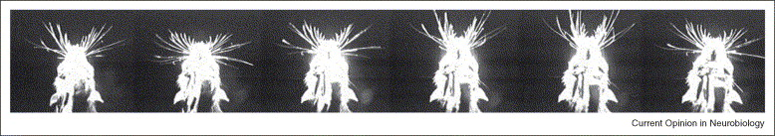
Whisking
≈ 125 ms

Slide 65
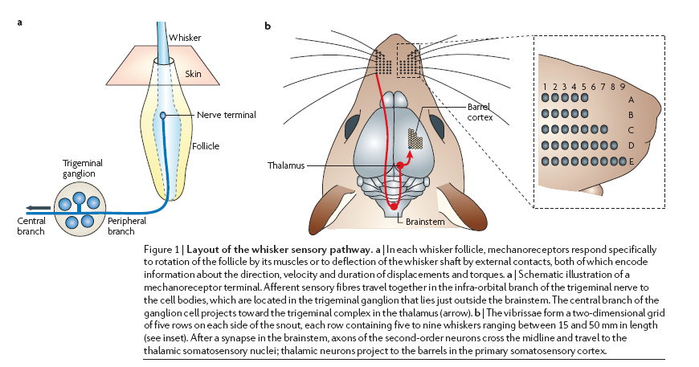
Rat somatosensory pathway
whisker representation
Diamond et al Nature Reviews Neurosci 2008

Slide 66
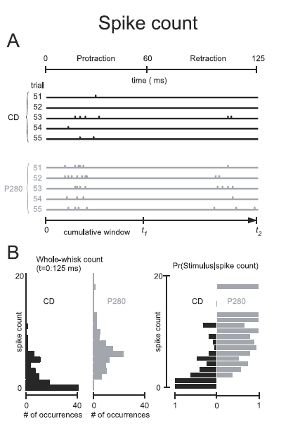
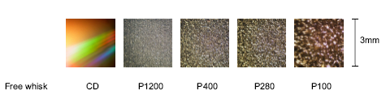
Recording from somatosensory cortex while the rat discriminates between different textures. Large differences in texture (CD vs sandpaper) are represented by spike counts

Slide 67
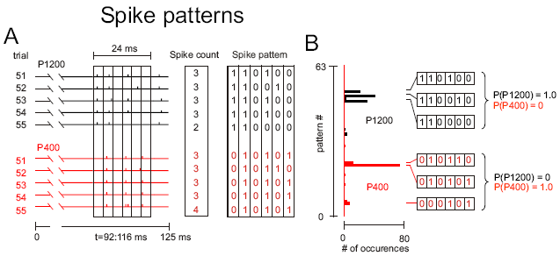
Fine Differences in sandpaper textures (P1200 vs P400) are represented by patterns of spike times but not by spike counts

Slide 68
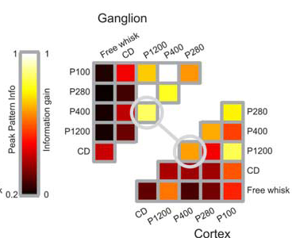
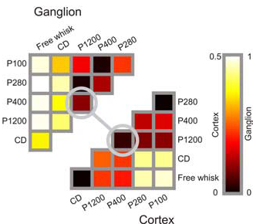
Spike count info
Additional spike timing info
Spike counts encode big texture differences
Spike times encode finer texture differences

Slide 69
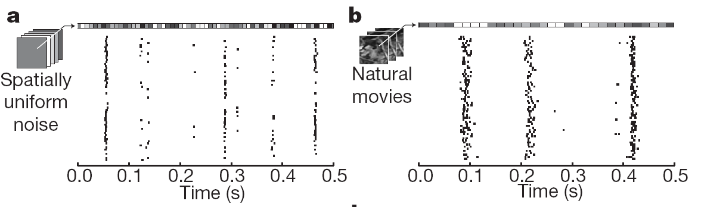
Precision depends on stimulus identity
In temporal code the reliability corresponds to the temporal precision of the response.
This is high for faster stimuli (such as random noise in each frame) and lower for slower stimuli (such as natural movies)
SR
Butts et al, Nature (2008)

Slide 70



Computing Information about movie stimuli
Trials
Time
s_{A}
s_{B}
1 sec
Information about which section of the dynamic stimulus elicited the considered neural response .
This quantification of information captures information about all possible stimulus features in the movie, including what and when property
Notes:
We evaluate which features of continuous signals are encoding information about an external stimulus
Information estimates number of bits shared between stimulus and response on average in a single trial
It takes into account contributions of correlations at all orders
We don’t need to specify a stimulus response model, we just need to compute response probabilities

Slide 71
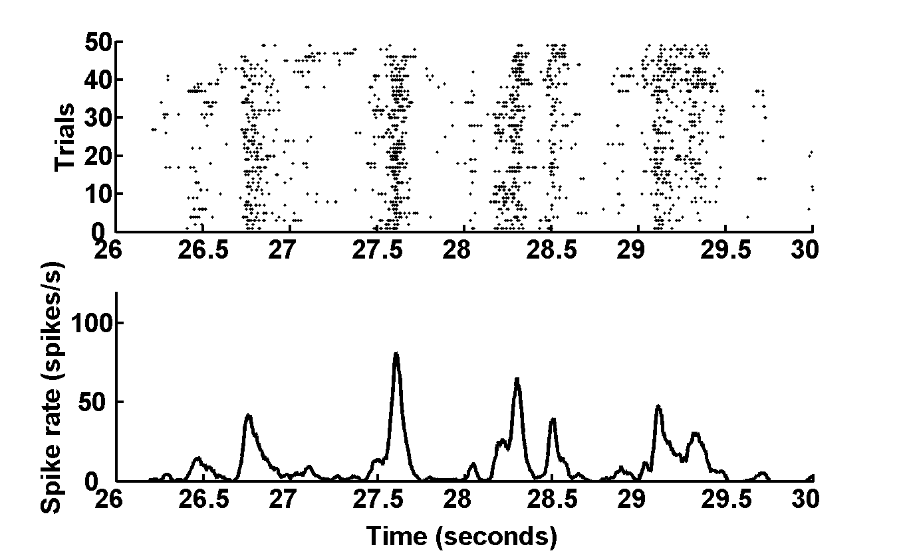

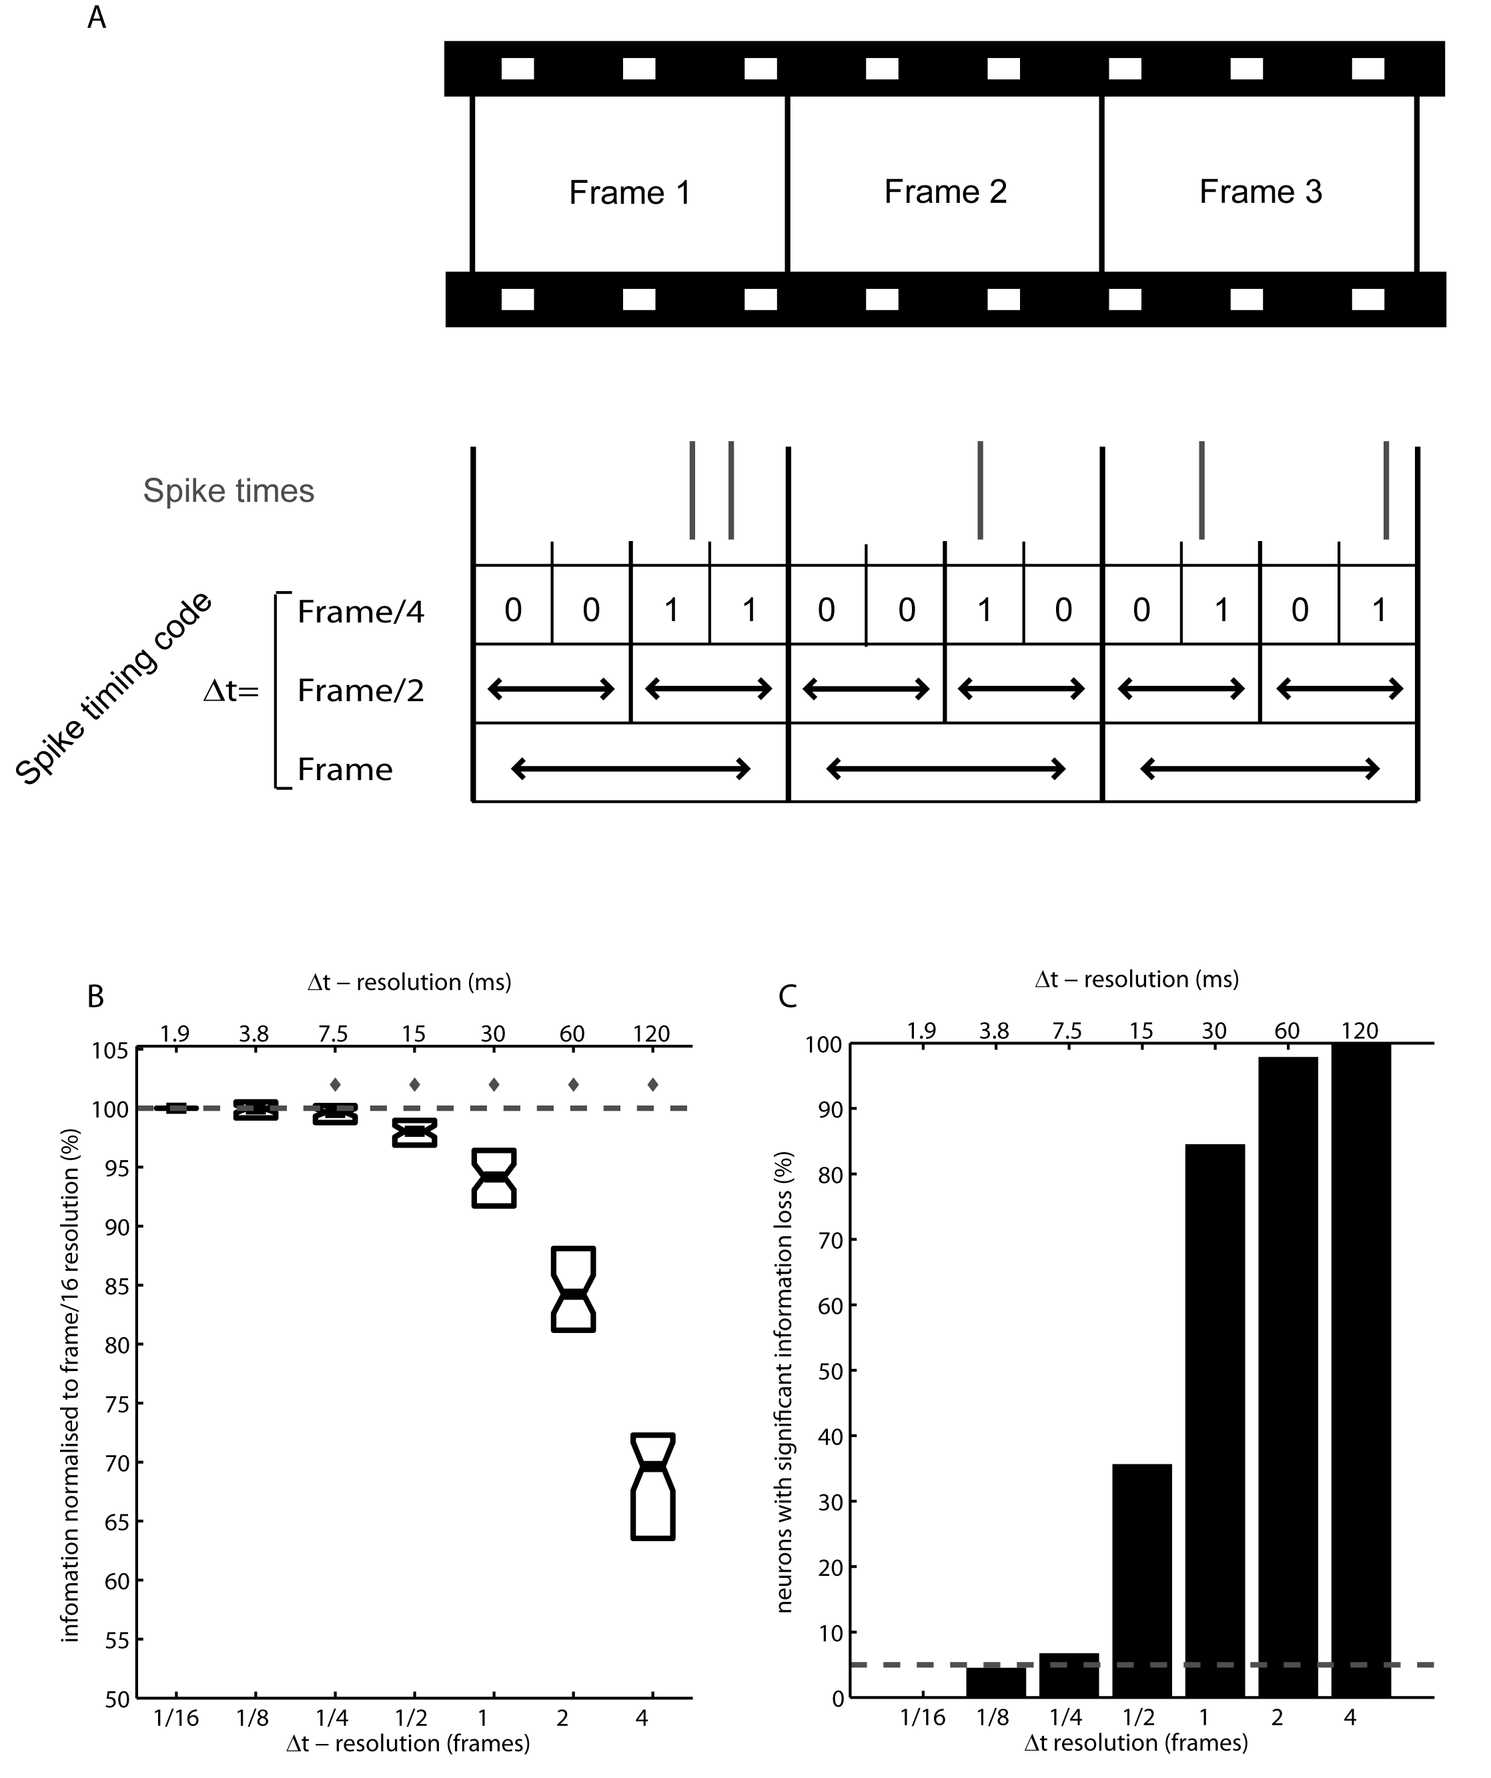
Ms-scale spike times carry visual information beyond that carried by spike counts

Slide 72
Spike patterns precision is of the order of 10-20 ms
Many neurons carry information with a precision finer than the fastest timescale in the movie (set by the movie frame rate of 30 Hz).
This suggests that spike patterns are a genuine temporal code.

Slide 73
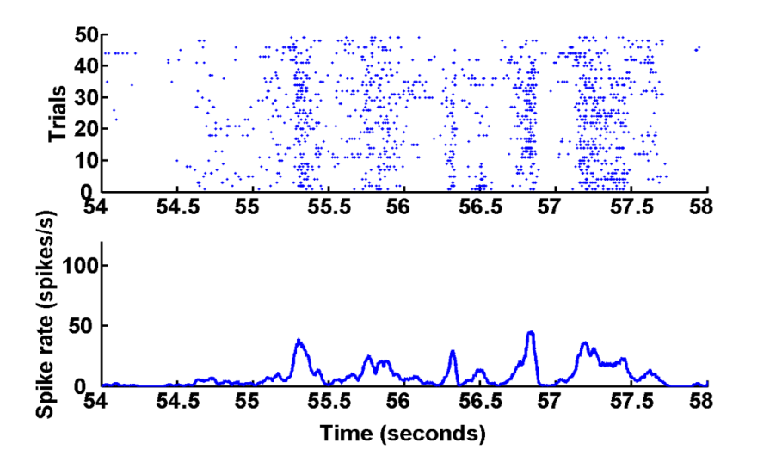
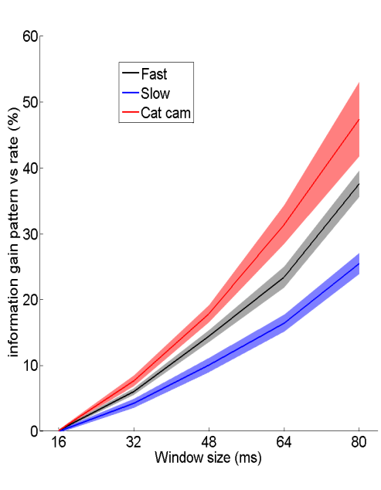

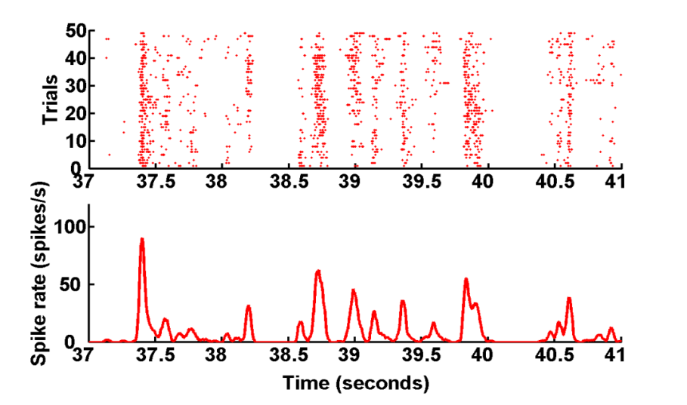

Spike pattern precision depends on stimulus features

Slide 74

Neural Coding example: oscillations

Slide 75
Role of fluctuations of cortical activity in sensory information coding
Cortical activity is characterized by wideband oscillations
Which frequency bands carry information about sensory variables?
Which sensory variables are encoded by each frequency band?
Prerequiste to understand function of these fluctuations – important to know what to measure and what to model
Crucial for clinical developments – Brain Machine Interfaces since is the only activity you can detect extracranially

Slide 76
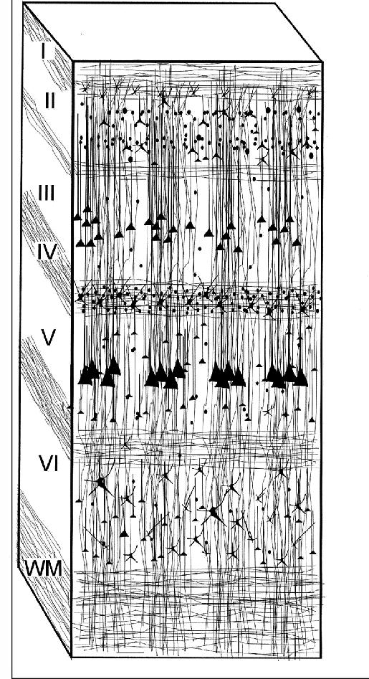
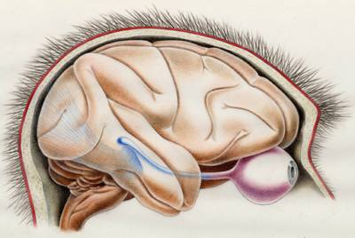
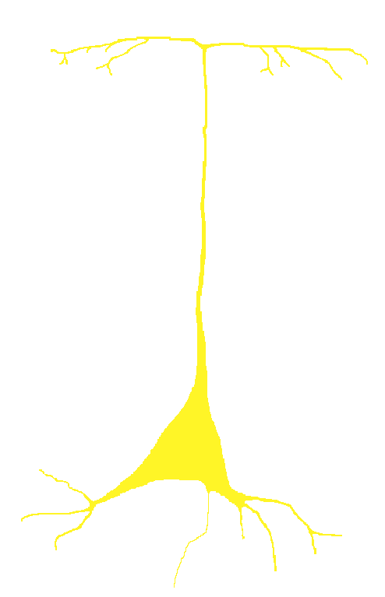
Local Field Potentials
Field potentials are operationally obtained by low pass filtering the extracellular signal
LFP
Field potentials measure (to a 1st approx) the superposition of dendrosomatic (dipole) fields generated in apical dendrites of Excitatory neurons
Being a synaptic signal, the LFP can capture subthreshold effects not captured by spikes
Integration area: approx 300 microns from electrode tip (“middle ground” signal)
Notes:
Many studies on brain function measure field-potentials, either using EEG or LFP. However, neither the sources generating these signals, nor the passive electrical spread of these fields through cortical tissue is well understood.
The resistive properties of the tissue determine how far a certain signal will spread, and hence also determine how many different sources could possibly be seen at any time.
From what is known (Ranck et al), currents spread mostly through the extracellular medium, not ‘through’ neurons. Hence, the resistive properties of the extracellular medium likely determine the properties of the signals recorded with microelectrodes.
The goal of this study was to characterize the resistive properties of the gray matter, using the monkey visual cortex as a model system.

Slide 77
Excitation Synaptic event
Synaptic
Activation
_
Cations+ enter
EEG and LFPs rely on sources and sinks (current flows)
Na+ moves from
high to low potential
Dendrite
+
Soma

Slide 78
Open Field
Excitatory
Input
_
Dendrite
Soma
+
Pyramidal Cell
Open Field

Slide 79
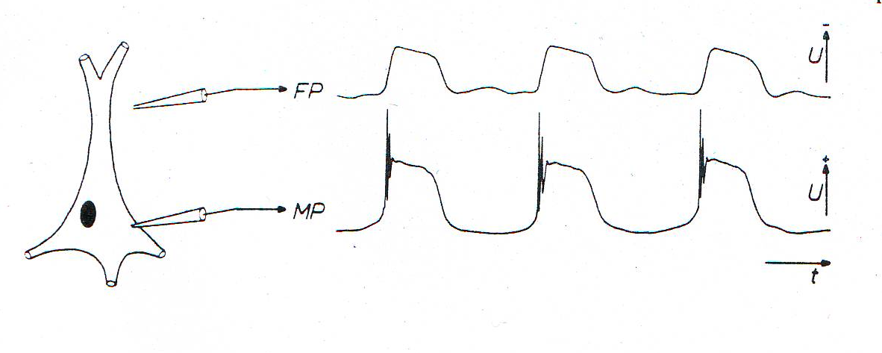
LFPs reflect synaptic inputs to pyramidal neurons
LFPs recorded with a medium-impedance electrode placed near layer 5 of cortex reflect a weighted average of dendro-somatic components of synaptic signals and correlate typical pattern of subthreshold oscillations of pyramidal neurons
They pick signals originating from neurons up to ~0.5 to 2 mm away

Slide 80

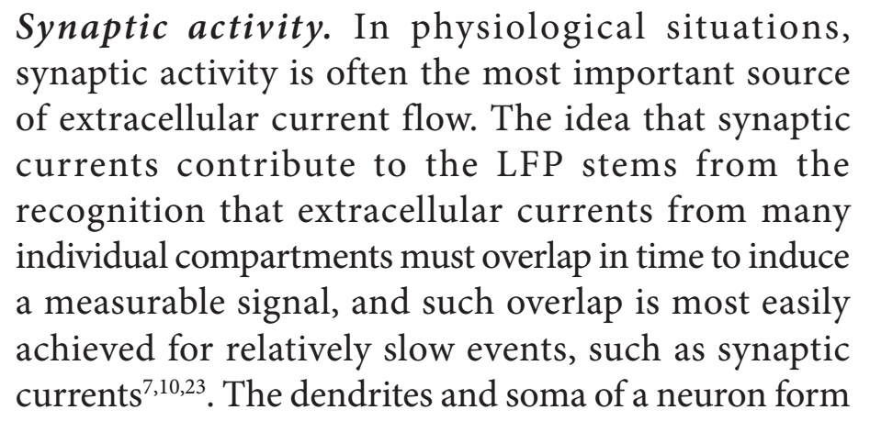
LFP origins
“Study carefully the second order dynamics of the phenomenon, understand it then forget about it”
Simon Laughlin, personal communication
Notes:
80
80

Slide 81
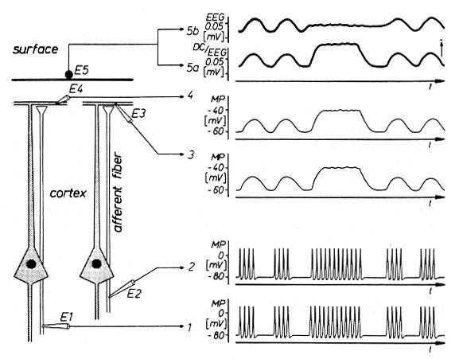
EEG Wave Generation
Excitatory input (E1 E2) from two afferents contacts distal dendrites of two P cells
Synaptic responses measured intracellularly from P cells’ dendrites by E3 and E4
Surface EEG measured by E5 as both EEG and DC-EEG traces
Synchronized groups of APs in afferent fibres generate wave-like dendritic EPSPs and corresponding wave-like EEG (and DC-EEG)

Slide 82
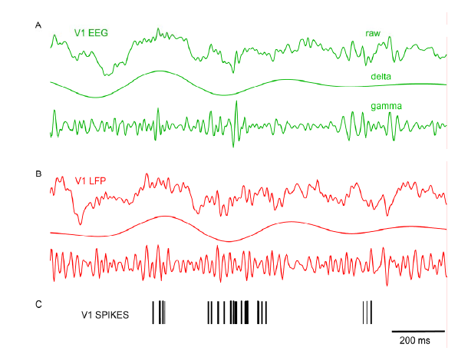
LFPs and EEGs share similar generation mechanism and similar dynamics

Slide 83
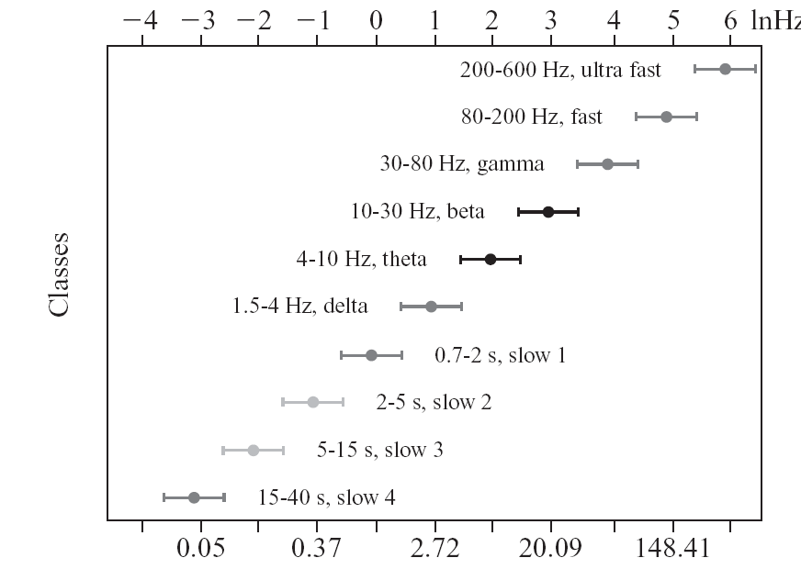
Fluctuations at lower frequencies have higher power and are coherent over a larger distance on the skull

Slide 84
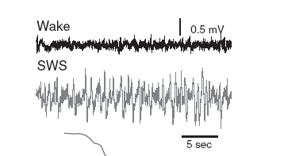
EEGs and LFPs are traditionally divided into frequency bands
Different bands relate to different behavioral or pathological states
(sleep vs wake, pathology vs normal function,...). These bands are believed to reflect different neural phenomena.
However, there is no evidence on the differences and interplay of different oscillations in responding to dynamic changes of the external stimulus
As a consequence, there is no rigorous determination of the band boundaries.
Up to 4 Hz: δ waves
4-8 Hz : θ waves
8-12 Hz: α waves
12-24 Hz: β waves
24-90 Hz : γ oscillations

Slide 85

Noise in the brain

Slide 86

Noise in the brain
Brown noise seems to be the right model, but what is its origin?
Media frequency-dependent resistivity, frequency dependent synchrony, single neuron dynamics?

Slide 87
Two seconds Local Field Potentials from V1
during movie presentations

Slide 88
Two seconds Local Field Potentials from V1
during movie presentations
High frequencies

Slide 89
Two seconds Local Field Potentials from V1
during movie presentations
Low frequencies

Slide 90
Two seconds Local Field Potentials from V1
During movie presentations
Unreliable intervals

Slide 91

Shannon’s Information
s
r
S = set of different “scenes” of the movies (2 seconds intervals)
R = power of different frequency bands (discretized into N levels)

Slide 92





Computing Information about movie stimuli
Time
1 sec
Information about which section of the dynamic stimulus elicited the considered neural response .
This quantification of information captures information about all possible stimulus features in the movie, including what and when property
Panzeri, Brunel, Logothetis, Kayser (2010) Trends Neurosci
Notes:
We evaluate which features of continuous signals are encoding information about an external stimulus
Information estimates number of bits shared between stimulus and response on average in a single trial
It takes into account contributions of correlations at all orders
We don’t need to specify a stimulus response model, we just need to compute response probabilities

Slide 93


Information in Power of V1 LFPs with naturalistic movies
δ,θ,α
γ
β
Two informative power signals: Low frequencies and gamma frequencies
High frequencies (γ and high γ) bands and low frequencies (α,θ,δ) carry independent information about the movie
Intermediate frequencies (β) do not carry much information
Belitski, Gretton, Magri, Murayama, Montemurro, Logothetis and Panzeri (2008) J Neurosci

Slide 94


Do different LFP bands convey similar or different information about the movie?
Redundancy: the difference between the information carried by the joint knowledge of the two signals and the sum of the information carried by each signal individually
Zero redundancy: the two signals carry independent information
Positive redundancy (joint information less than the sum): the two signals share at least in part the same information

